Slide 1
Segmentation, Targeting and Positioning Strategy
Market Segmentation
Unit 5

Slide 2
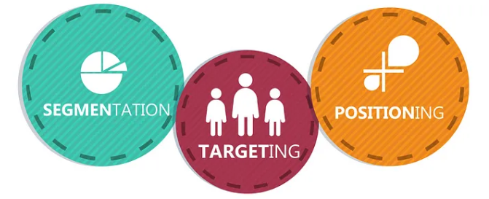

Slide 3
Market Segmentation
Market Segmentation refers to the process of dividing a target market into smaller groups with comparable characteristics, such as age, income, personality traits, behavior, interests, demands, or geography. Knowing the market segmentation allows marketers to target their product, sales and marketing strategies better. It can aid in product development processes by directing how to construct offerings for different groups, such as men versus women or high-income groups versus low-income groups. These divisions can be utilized to improve product design, marketing, promotion, and sales. The overall objective of market segmentation is to reduce risk by identifying which items have the best possibility of capturing a share of a target market and by identifying the most effective means of distributing those products to that market. This enables the business to boost efficiency by concentrating scarce resources on initiatives that yield the highest.

Slide 4
Definitions
“Market segmentation is a process of dividing the total market for a goods or services into several smaller groups, such as that members of each group are similar with respect to the factors that influence demand”. (William J. Stanton, Michael J. Etzel and Bruce J. Walker)
“Market segment is the act of identifying and profiling distinct group of buyers who might require separate product and /or marketing mixes”. (Philp Kotler)
“Market segmentation is naming broad product markets and segmenting these broad product markets in order to select target market and develop suitable marketing mixes”. ( E, Jerome McCarthy)

Slide 5
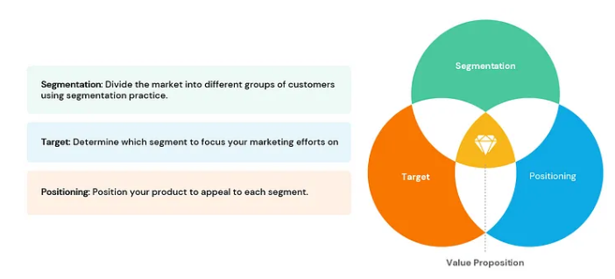

Slide 6
Process of Market Segmentation
Market should not be segmented on the basis of guesses or hunch estimation. A proper basis and process should be followed for it. The main task are information collection, survey, analysis of information, profile preparation and selection of market segments.
Market Survey: Collecting information through survey is the first stage of market segmentation. While collecting information, special attention should be paid to customers’ need, interest, characters, features of product, brand awareness, product using style, customers’ tendency towards classification of goods, geographical and psychological features of customers etc. Besides this, information about education, age, fashion, practice and custom, religion, purchasing power, purchasing behavior, buying motives, purpose etc. should be collected. Business organization should adopt proper methods and processes to conduct market survey.

Slide 7
Analysis: After the information has been collected through survey, it should be carefully studied and analyzed. Proper statistical tools should be used to analyze the information. The demand affecting variables should be classified into special and general categories. Such variables should be analyzed in context of customers’ need and their characters.
Profiling: In the third stage, market segmentation profile should be prepared by identifying the basis of market segmentation. Profiles of each segment should be prepared on the basis of customers’ need and their character. Character and need of the customers of each segment can be identified by studying the profiles. Preparing profiles of each market segment in several alternatives of market segments can be found from which better alternative can be selected. For instance, data collected, focus group, market research report, survey questionnaire etc. Profiling a market segment involves identifying and understanding distinct groups within a broader market. This process helps businesses tailor their marketing strategies to specific groups, ensuring more effective targeting and improved customer satisfaction.

Slide 8
Evaluation of market segment: After completing the segmentation of market, they should be evaluated, and better market segments should be identified. While evaluating market segment, the company should analyze the size of the segments, and growth (on the basis of efficiency, resource and means), structural attraction of the segment (it should consider competitor, substitute product, buyers' power, supplier power) and goal and resource of the company (while analyzing market segments, production facilities, employees and their ability, financial condition, means and resources also should be considered).
Selection of the market segment: Selection of market segmentation is the final stage of market segmentation process. In this stage, the profile of market segmentation is evaluated carefully, and one or more market segments are selected. The selected market segments are the targeted market of business organizations.

Slide 9
Requirement for Effective Segmentation
To ensure effective market segmentation, segments must meet certain key requirements. These criteria help businesses identify, evaluate, and select segments that are viable and profitable. Here are the essential requirements:
Measurable: After market segmentation is done, we can clearly define the size, profile and purchasing power of each segment. This implies that we have access to reliable data (for example census data) or a reliable way of measuring segments. For example, knowing that your product is a perfect fit for people that have a specific height is not relevant as you do not have access to height data in specific regions, and the region average might differ from the overall country average. In a similar manner, purchase power, consumption rates, habits, cultural differences, physical characteristics and many other criteria, even if they would be very relevant for your market segmentation, are almost impossible to determine for specific regions. The size, purchasing power, and profiles of the segments should be quantifiable. Businesses need reliable data to measure the segment's potential.

Slide 10
Accessible: While the segments themselves might be correctly established, you also need to be able to reach these segments with your message and your products. For example, you can be certain that your product is best suited for VPs and CEOs (based on education, income, availability to spend, social expectations), but there are very few ways to reach top management people directly. Therefore, the segment must be reachable through marketing and distribution channels and should be effective means to deliver products or services to the segment.
Substantial: If the strategist is to justify the development of a segment, the exercise must be cost-effective. The size and value of the segment, therefore, is an important determinant of this decision. Size should, of course, be seen in relative rather than absolute terms, since what may be too small to be considered by one organization may be appropriate to another, smaller, company.

Slide 11
Differential: The differential market segment process is a strategy used by businesses to divide a broad target market into subsets of consumers who have common needs and priorities, and then design and implement strategies tailored to these segments. This approach helps businesses better address the specific preferences of different customer groups and can lead to more effective marketing, product development, and customer satisfaction. Each segment is well defined by unique needs, desires and characteristics that do not overlap (as much as possible). This allows for specific approaches, messages and campaigns dedicated for each segment. Let's consider a company that sells athletic footwear: The company finds that urban, high-income, fitness enthusiasts who frequently buy athletic footwear represent a profitable segment. The company targets high-income urban fitness enthusiasts with a differentiated strategy. Launch the new product line and track sales performance, customer feedback, and market share. Make adjustments to the marketing strategy based on the results.

Slide 12
Actionable: Depending on the approach, segments might be too difficult or too expensive to reach. Even if the segmentation is correct, the inability to take proper actions towards marketing to specific segments makes these segments useless. The goal is to create segments for which you are able to take actions (implicitly create and run your marketing campaigns) and then be able to evaluate the results.

Slide 13
Base for Consumer Market Segmentation
The market of consumer goods is called consumer market. In other word, the total demand of final consumers is consumer market. The goods, which are used by family, family members of persons, are consumer goods. Foodstuff, clothes, radio, television, etc. are consumer goods. The market of these very things is called consumer market.
Religion, education, age, purchasing power, gender, race and caste, occupation, urbanization, purchasing purpose, etc. directly affect consumer market. So, a business organization should study and analyze such aspects of customers for business success. Consumer market can be segmented on the basis of four major variables. They are geographic variables, demographic variables, psychographic variables and behavioral variables.

Slide 14
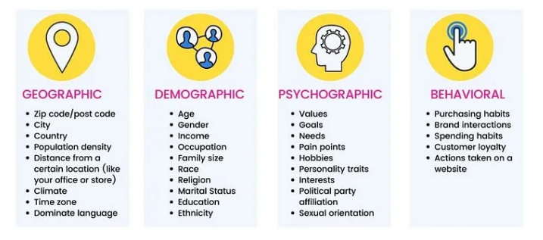

Slide 15
Geographic segmentation: It is one of the oldest and simplest methods of dividing the customer market on the basis of the geographical location/ boundaries of the customers. For example, lifestyle products sell very well in big cities then in small towns. People living in rural and urban region of the country have different purchasing or buying habits. Therefore, services or product has to be designed keeping in mind the different preferences of each customer groups. A fast-food chain might change its menu items and specials based on what people in a certain area like. For example, they might have spicy food on the menu in places where spicy food is common.
The needs and interests of potential consumers vary according to their geographic location, climate, and region. So, geographic segmentation is valuable. Understanding geographic segmentation allows you to determine where to sell, advertise a brand and where to expand a business.

Slide 16
Demographic segmentation: It is dividing the customer market on the basis of several variables such as age, sex, gender, occupation, income, education, marital status, family life cycle, community, social status, nationality etc. For example, buying behavior of car, beauty products, mobile phones, cards, apparels, are hugely influenced by their demographics. A company that sells luxury cars might look for customers with a certain income, age, or job. For example, they might make ads for older, wealthy people who are likely to be interested in luxury cars.
Demographic segmentation is one of the most widely used forms of market segmentation since it is based on knowing how customers use your products and services and how much they are willing to pay for them. Surely demographic segmentation is very significant.

Slide 17
Psychographic segmentation: It is dividing the customer market on the basis personality, lifestyles, attitudes and habits of an individual. The personality refers to the traits which characterize persons as introvert, extrovert ambitious etc. Lifestyles refer to how a persons lives his life and do the expenditures. For example, person having a lavish lifestyle may consider having an air conditioner in every room as a need, whereas a person living in the same city but having a conservative lifestyle may consider it as a luxury. A fitness brand might try to reach customers based on how they live and who they are. For example, they might go after people who like to be active and care about their health.
To understand the target audience, market research methods such as focus group, surveys, interviews, and case studies can successfully compile psychographic segmentation.

Slide 18
Behavioral segmentation: It is dividing the market on the basis of the individual’s knowledge about the product and the usage of the product. The customer can be segmented into those who know about the product, those who don’t know about the product, Ex users, Potential users, Current Users First time users, etc. For example, an athlete may prefer to buy running shoes to participate in marathon race and a non-athlete person may buy it just because he likes the shoes. An online store can target customers based on what they buy. For example, they might give discounts to people who buy from them often or send personalized suggestions based on what people have bought in the past.
The public’s attitudes towards your brand, how they use it, and their awareness are examples of behavioral segmentation. Collecting behavioral segmentation data is similar to how you would find psychographic data. This allows marketers to develop a more targeted approach.

Slide 19

Thank you

